Slide 1
Solid State Physics
Statistical Mechanics
Band Theory of Solids

Slide 2
Statistical Distributions
E:- total energy of the system; N:- total number of particles in the system
E is distributed among N particles of the system at absolute temperature T.
N remains constant except for the system of photons or phonons.
ε₁, ε₂, ε₃, ε₄, ε₅, ε₆, …….., ε_{n}
n₁, n₂, n₃, n₄, n₅, n₆, …………, n_{n}
E = n₁ε₁+ n₂ε₂+ n₃ε₃+ n₄ε₄+ ……..+ n_{n}ε_{n}
N = n₁, n₂, n₃, n₄, n₅, n₆, …………, n_{n}
The number of particles n(ε ) with energy ε
And n(ε) = g(ε) f(ε),
where f(ε) is distribution function. It gives average number of particles in each state of energy ε i.e. the probability of occupancy of each state of energy ε and
G(ε) is the number of states in the energy ε. Statistical weight corresponding to each energy ε.
For continuous distribution g(ε) is replaced by g(ε)d ε. And the number of states with an energy between ε and ε+d ε.

Slide 3
Statistical distributions
Maxwell–Boltzmann statistics
Bose–Einstein statistics
Fermi–Dirac statistics

Slide 4
Statistical Distributions
Maxwell–Boltzmann statistics describes the average distribution of non-interacting material particles over various energy states in thermal equilibrium, and is applicable when the temperature is high enough or the particle density is low enough to render quantum effects negligible.
Bose–Einstein statistics is one of two possible ways in which a collection of non-interacting indistinguishable particles may occupy a set of available discrete energy states, at thermodynamic equilibrium.
Fermi–Dirac statistics describe a distribution of particles over energy states in systems consisting of many identical particles that obey the Pauli exclusion principle.

Slide 5


Maxwell–Boltzmann statistics
The average energy of an ideal gas molecule = E/N.
Total energy of N gas molecules, E =3NkT/2
Average molecular energy
RMS speed

Slide 6
Three Statistics
Sr. No. | Maxwell_Boltzmann | Bose-Einstein distribution | Fermi-Dirac distribution
1 | Identical particles | Identical particles | Identical particles
2 | Molecules of gas e.g. oxygen, carbon dioxide etc. | Bosons, particles with 0 or integral spin (1,2,3,4,5,….) | Fermions, particles with odd half integral spins i.e. ½, 3/2, 5/2, ……..
3 | Do not obey Pauli’s exclusion principle, any number of particles can exist in the same quantum state of system | Do not obey Pauli’s exclusion principle, any number of particles can exist in the same quantum state of system | Obey Pauli’s exclusion principle, only one fermion can exist in a particular quantum state of system
4 | Sufficiently apart and distinguishable | Indistinguishable and not sufficiently apart | Indistinguishable and not sufficiently apart
5 | Wavefunctions do not overlap or overlap to negligible extent | Wavefunctions overlaps Wavefunction of system is not affected by exchange of any pair of particles | Wavefunctions overlap and wavefunction changes sign upon exchange of any pair

Slide 7


Three Statistics
Sr. | Maxwell_Boltzmann | Bose-Einstein distribution | Fermi-Dirac distribution
6 | Wavefunctions do not overlap or overlap to negligible extent | Wavefunctions overlaps Wavefunction of system is not affected by exchange of any pair of particles | Wavefunctions overlap and wavefunction changes sign upon exchange of any pair
7 | --------- | Symmetric wavefunction | Anti-Symmetric
8 | n(ε) = A g(ε) e^{-ε/kT}, g(ε) is the partition function
9 | Maxwell-Boltzman distribution function f_{MB}(ε) = A e^{-ε/kT}, constant depends on the number of particles in the system | Bose-Einstein distribution function , Constant alpha depends on the properties of particular system and may be a function of temperature | Fermi-Dirac distribution function Constant alpha depends on the properties of particular system and may be a function of temperature
10 | No limit to the number of particles per state | No limit to number of particles per state, more particles per state than f_{MB} at low energies; approaches f_{MB} at high energies | Never more than 1 particle per state, fewer particles per state than f_{MB} at low energies; approaches f_{MB} at high energies

Slide 8
Distribution functions
The probablity f(ε) that a boson occupies a state of energy ε turns to be
Bose Einstein distribution function
The probability for a fermions turns to be
Fermi Dirac distribution function

Slide 9
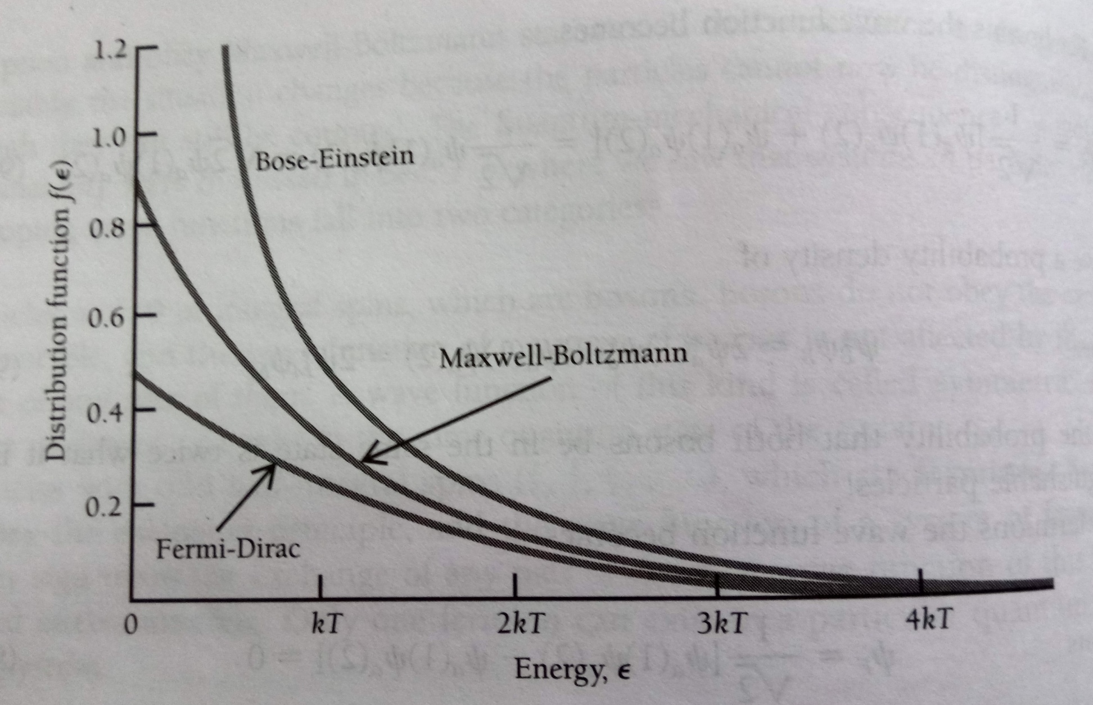
Comparison of three distribution functions
f_{MB}(ε) = A e^{-ε/kT}

Slide 10
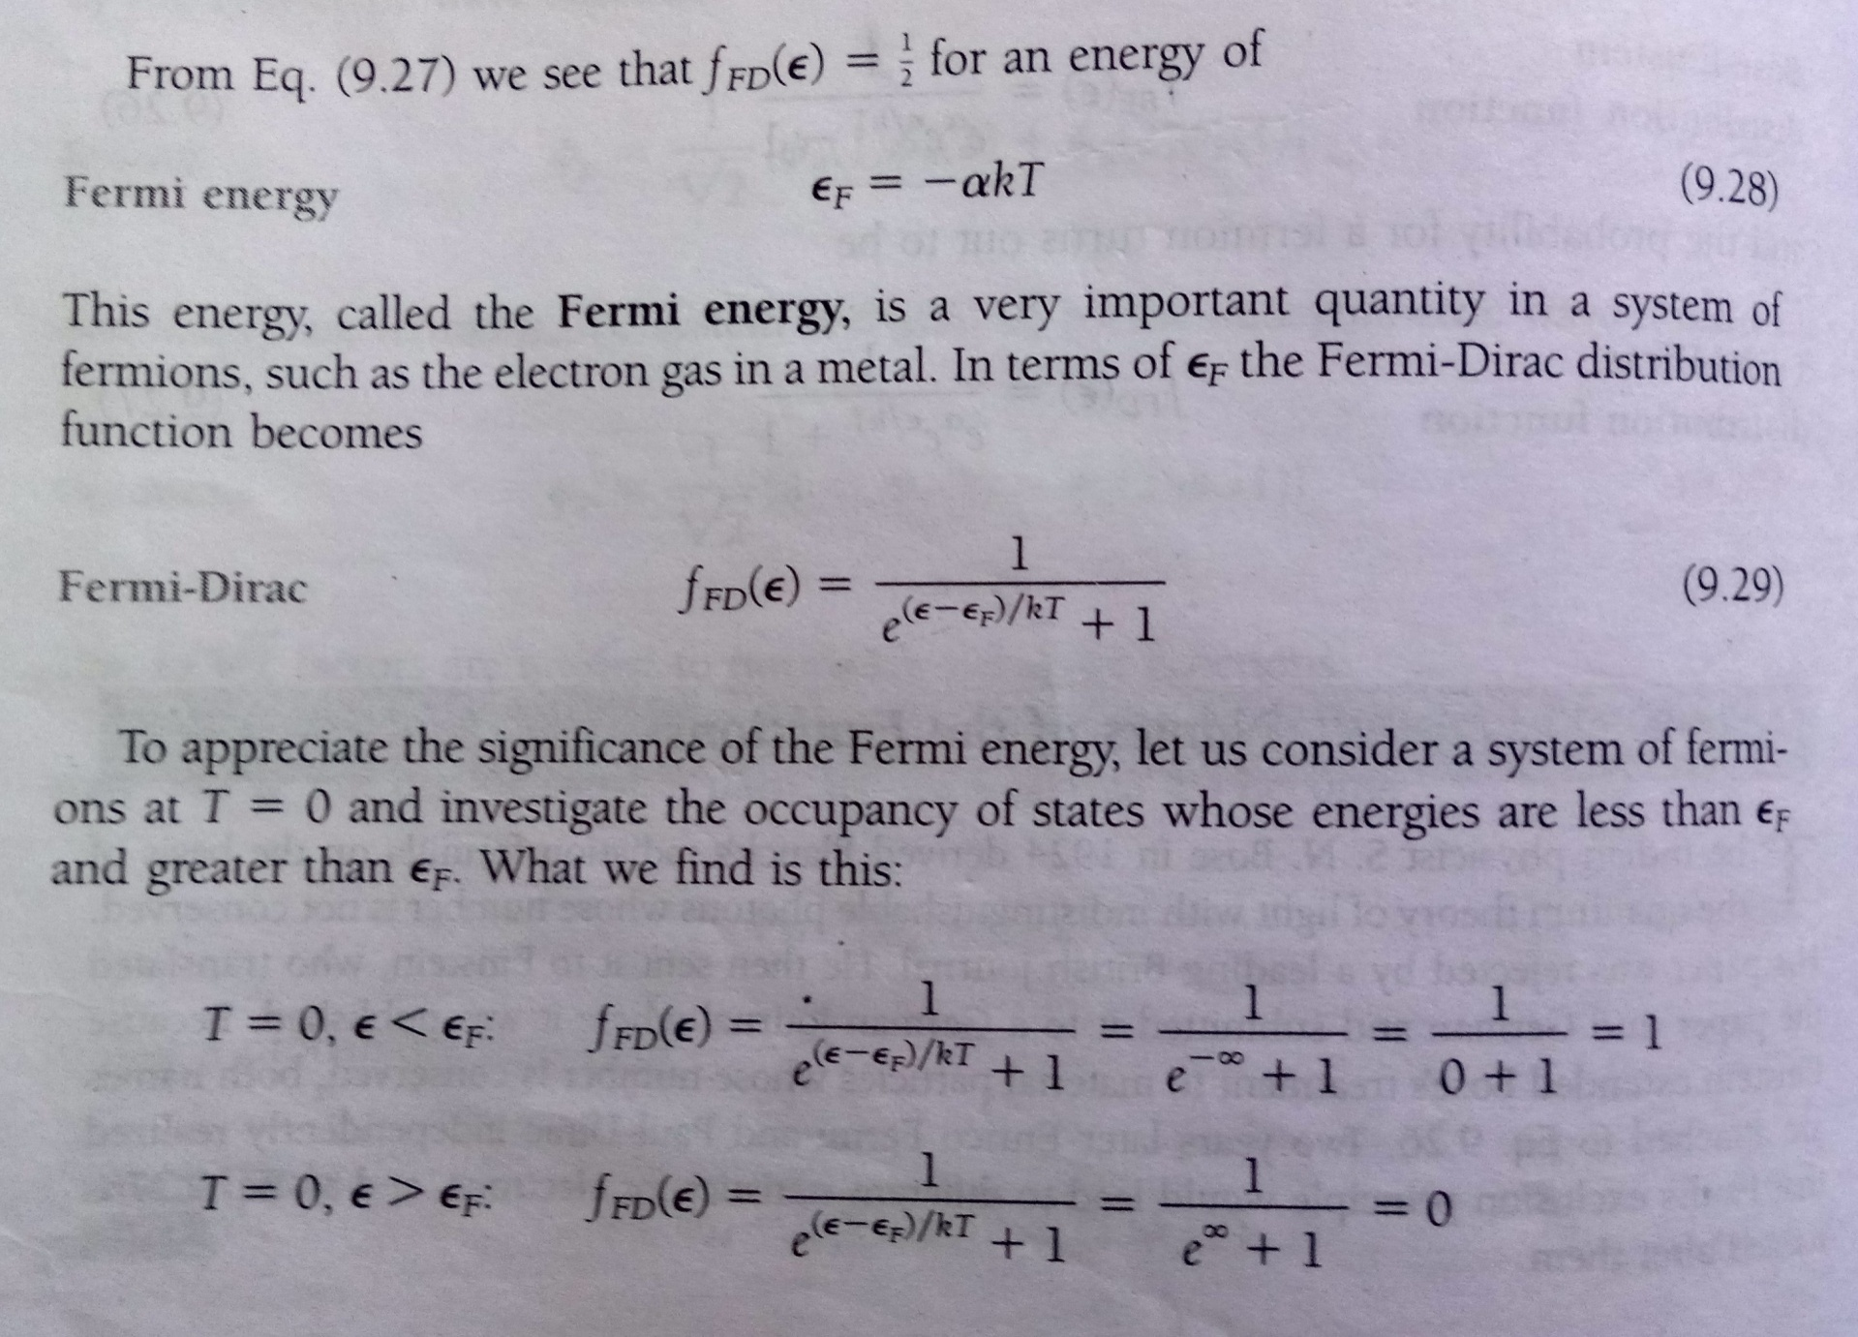

Slide 11

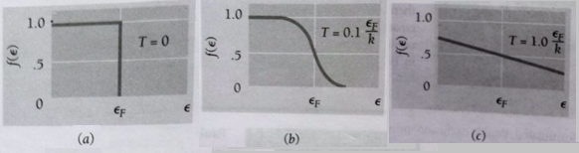
Distribution function for fermions at three different temperatures
(a) at T = 0, all the energy states up to the Fermi energy ε_{F} are occupied.
(b) AT low temperature, some fermions will leave states just below the ε_{F} and move into states just above ε_{F}.
(c) AT higher temperature, some fermions from any state below the ε_{F} may move into states above ε_{F}.
https://www.youtube.com/watch?v=ZWUiDL4cgC0

Slide 12
Bands in Solids
Dr. Jeeban

Slide 13
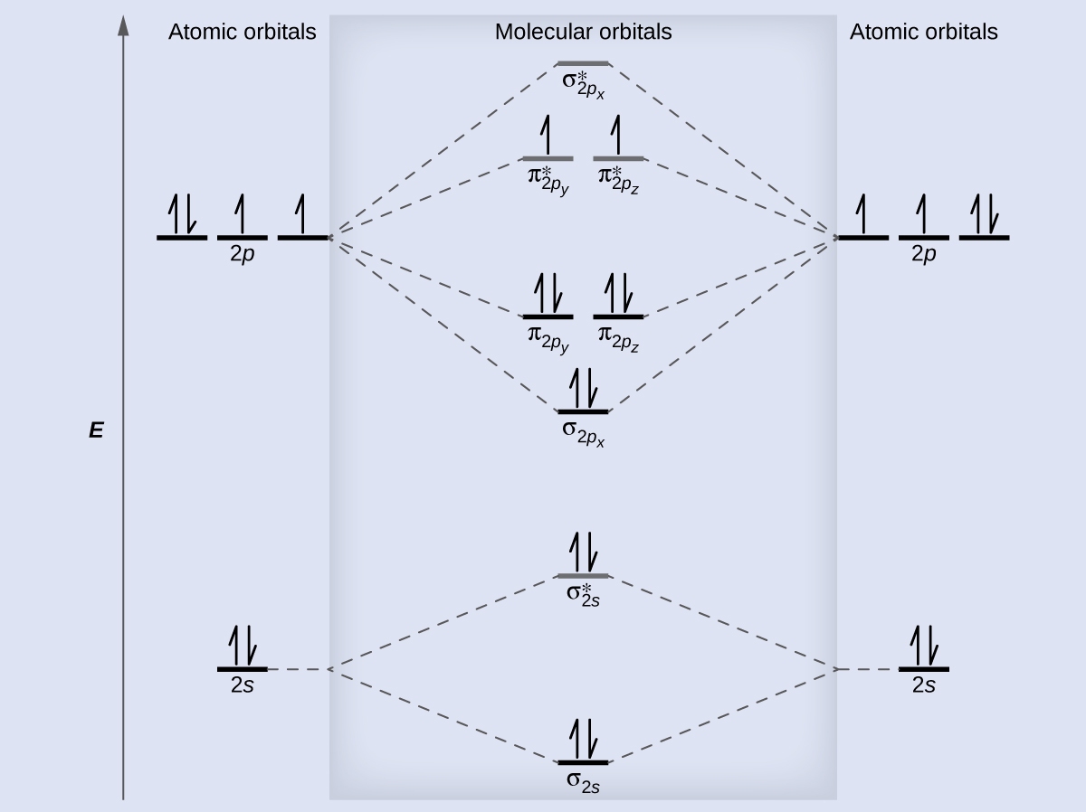
Molecular Orbitals

Slide 14
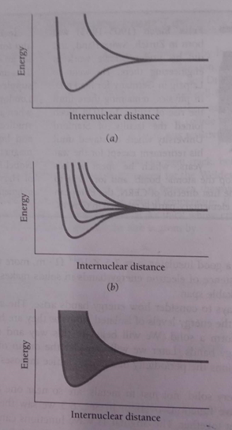
The 3s level is the highest occupied level in a ground state sodium atom.
(a) When two sodium atoms come close together, their 3s levels initially equal, becomes two separate levels because of the overlap of the corresponding electron wave functions.
(b) The number of new levels equals the number of interacting atoms.
(c) When the number of interacting atoms is very large, as in solid sodium, the result is an energy band of very closely spaced levels.

Slide 15
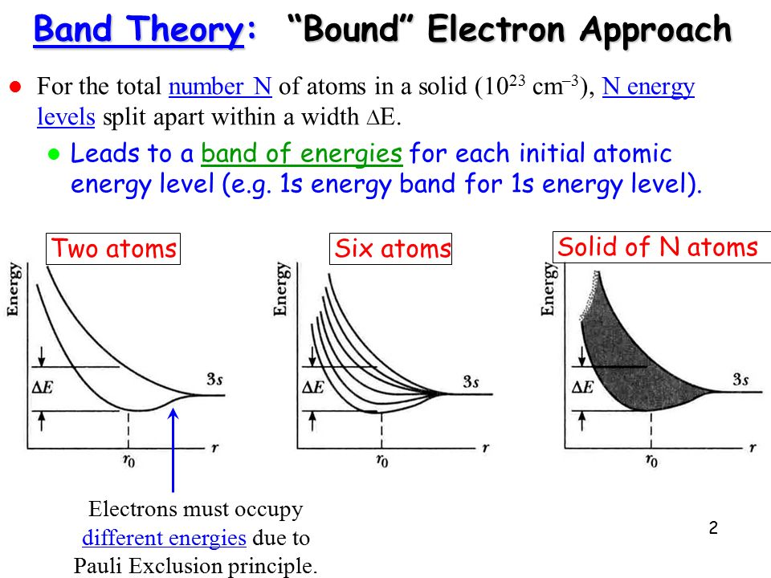

Slide 16
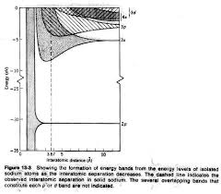
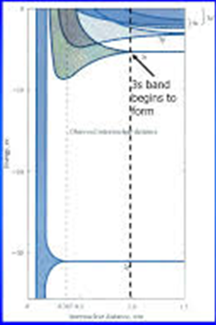
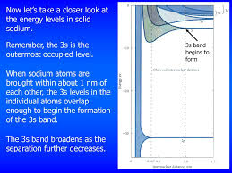
Energy Band formation

Slide 17


Slide 18
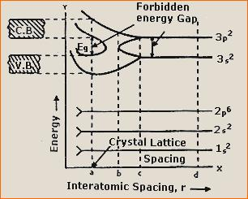
Notes:
In solids, the discrete energy levels of isolated atoms broadens into allowed energy bands separated by forbidden gaps.
The separation and electron population of the highest bands determine whether the solid is a conductor, an insulator or a semiconductor.

Slide 19
Band Formation in Silicon
In a solid, many atoms are brought together, so that the split energy levels form essentially continuous bands of energies.
Each isolated silicon atom has an electronic structure
1s² 2s² 2p ⁶ 3s² 3p² in the ground state.
Each atom has available two Is states, two 2s states, six 2p states, two 3s states, six 3p states, and higher states.
If we consider N atoms, there will be 2N, 2N, 6N, 2N, and 6N quantum states of type Is, 2s, 2p, 3s, and 3p, respectively.
As the interatomic spacing decreases, these energy levels split into bands, beginning with the outer (n = 3) shell.
As the "3s" and "3p" bands grow, they merge into a single band composed of a mixture of energy levels.
This band of "3s-3p" levels contains 8N available quantum states.

Slide 20
Band Formation in Silicon
As the distance between atoms approaches the equilibrium interatomic spacing of silicon, this band splits into two bands separated by an energy gap Eg.
The upper band (called the conduction band) contains 4N quantum states, as does the lower (valence) band.
Thus, apart from the low-lying and tightly bound "core" lev­els, the silicon crystal has two bands of available energy levels separated by an energy gap E_{g} wide, which contains no allowed energy levels for electrons to occupy.
This gap is sometimes called a "forbidden band," since in a perfect crystal it contains no electron energy states.

Slide 21
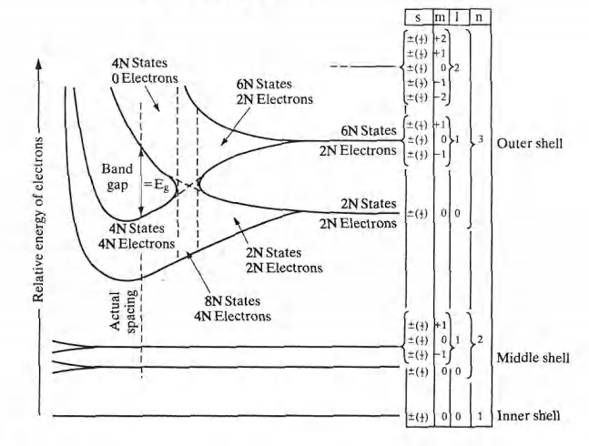
Band Formation in Silicon

Slide 22
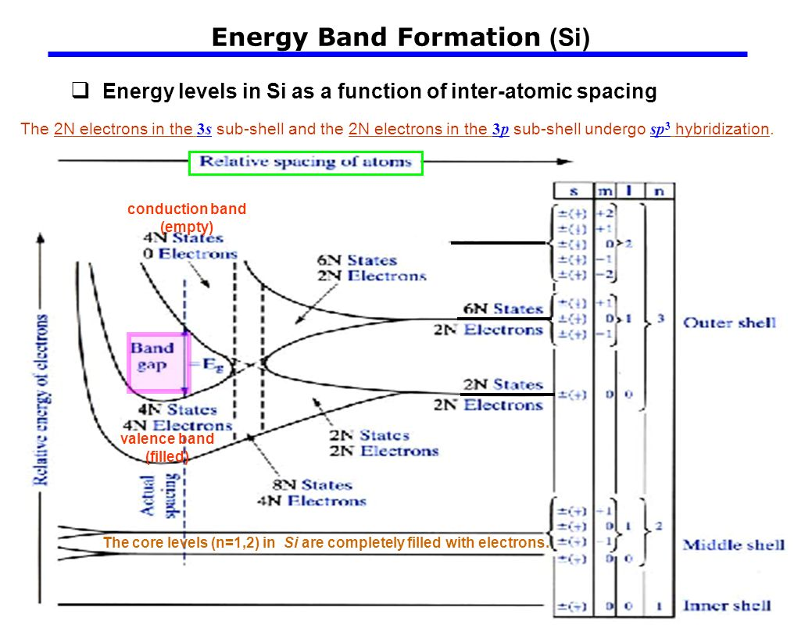

Slide 23
Formation of bands in Silicon
The core levels (n = 1,2) in Si are completely filled with electrons.
At the actual atomic spacing of the crystal, the 2N electrons in the 3s subshell and the 2N electrons in the 3p subshell undergo sp² hybridization, and
all end up in the lower 4N quantum states (va­lence band), while the higher-lying 4N quantum states (conduction band) are empty, separated by a band gap.

Slide 24
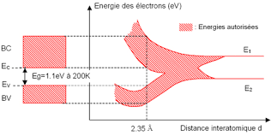
Band Formation in Silicon

Slide 25
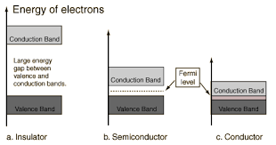
Band gap in the solids

Slide 26
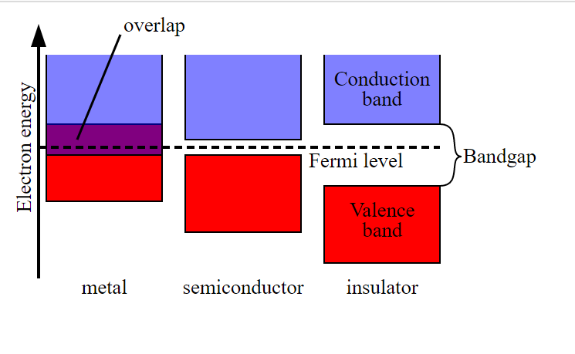
Band Formation

Slide 27
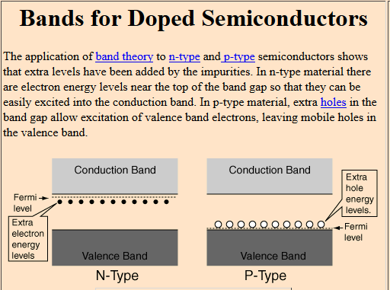

Slide 28

Direct and Indirect Semiconductors
A single electron is assumed to travel through a perfectly periodic lattice.
The wave function of the electron is assumed to be in the form of a plane wave moving, for example, in the x- direction with propagation constant k, also called a wave vector. The space-dependent wave function for the electron is
where the function U(k_{x}, x) modulates the wave function according to the periodicity of the lattice.

Slide 29
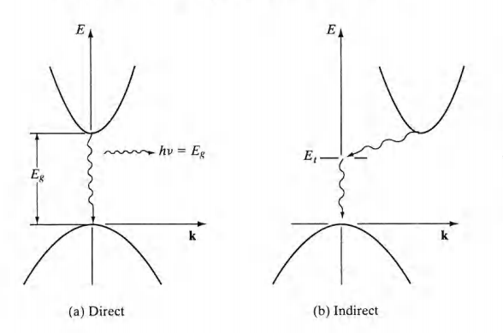
Direct and Indirect Semiconductors
GaAs has a minimum in the conduction band and a maximum in the valence band for the same k value (k = 0).
Si has its valence band maximum at a different value of k than its con­duction band minimum.

Slide 30
Direct and Indirect Semiconductors
The band structure of GaAs has a minimum in the conduction band and a maximum in the valence band for the same k value (k = 0).
On the other hand, Si has its valence band maximum at a different value of k than its con­duction band minimum.
Thus an electron making a smallest-energy transition from the conduction band to the valence band in GaAs can do so without a change in k value;
on the other hand, a transition from the minimum point in the Si conduction band to the maximum point of the valence band requires some change in k.
Thus there are two classes of semiconductor energy bands; direct and indirect.
It can be seen that in an indirect transition, involving a change in k, requires a change of momentum for the electron.

Slide 31
Direct and Indirect Semiconductors
In a direct semiconductor such as GaAs, an electron in the conduction band can fall to an empty state in the valence band, giving off the energy differ­ence E_{g} as a photon of light.
On the other hand, an electron in the conduc­tion band minimum of an indirect semiconductor such as Si cannot fall directly to the valence band maximum but must undergo a momentum change as well as changing its energy.
For example, it may go through some defect state (E_{t}) within the band gap.
In an indirect transition which involves a change in k, part of the energy is generally given up as heat to the lattice rather than as an emitted photon.
This difference between direct and indirect band struc­tures is very important for deciding which semiconductors can be used in de­vices requiring light output.
For example, semiconductor light emitters and lasers generally must be made of materials capable of direct band-to-band transitions
or of indirect materials with vertical transitions between defect states.

Slide 32
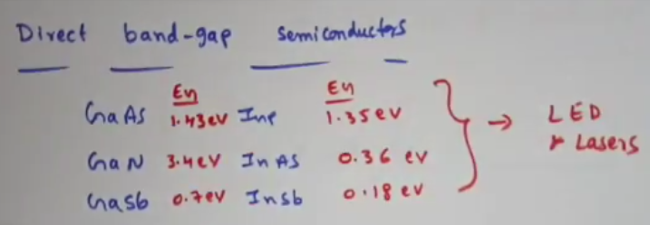
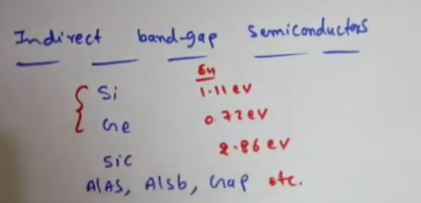

Slide 33
Variation of Energy bands
As III-V ternary and quaternary alloys are varied over their composition ranges, their band structures change.
For example, the band structure of GaAs and AlAs, and the way in which the bands change with composition x in the ternary compound Al_{x}Ga_{1-x} As.

Slide 34
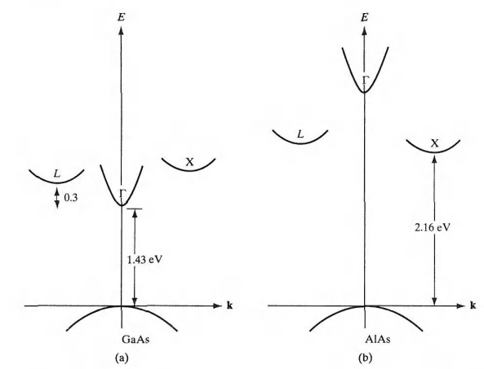
Variation of direct and indirect conduction bands in AIGaAs as a function of composition
The (E,k) diagram for AlAs, showing three minima in the conduction band;
The (E,k) diagram for GaAs, showing three minima in the conduction band;

Slide 35
Variation of Energy bands
The binary compound GaAs is a direct material, with a band gap of 1.43 eV at room temperature.
For reference, we call the direct ( k = 0) conduction band minimum Γ.
There are also two higher-lying indirect minima in the GaAs conduction band, but these are sufficiently far above Γ that few electrons reside there.
We call the lowest-lying GaAs indirect minimum L and the other X.
In AlAs the direct Γ minimum is much higher than the indirect X minimum, and this ma­terial is therefore indirect with a band gap of 2.16 eV at room temperature.

Slide 36
Variation of Energy bands
Since light emission is most efficient for direct materials, in which elec­trons can drop from the conduction band to the valence band without chang­ing k (and therefore momentum),
LEDs in GaAsP are generally made in material grown with a composition less than x = 0.45.
For example, most red LEDs in this material are made at about x =0.4, where the Γ minimum is still the lowest-lying conduction band edge, and
where the photon resulting from a direct transition from this band to the valence band is in the red portion of the spectrum (about 1.9 eV).
The radiative re­combination in indirect materials can be enhanced by adding the impurities.

Slide 37
Effective Mass

Slide 38
Effective Mass
The electrons in a crystal are
not completely free,
interact with the periodic potential of the lattice.
As a result, their "wave-particle" motion cannot be expected to be the same as for electrons in free space.
Thus, in ap­plying the usual equations of electrodynamics to charge carriers in a solid, the altered values of particle mass should be used.
To account for most of the influences of the lattice, so that the electrons and holes can be treated as "almost free" carriers in most computations.
The calculation of effective mass must take into account the shape of the energy bands in three-dimensional k-space, taking appropriate averages over the various energy bands.

Slide 39
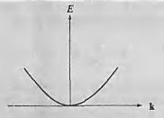


Effective Mass
the electron momentum is p = mv = ħk. Then
Thus the electron energy is parabolic with wave vector k. The electron mass is inversely related to the curvature (second derivative) of the (E, k) relationship, since
Although electrons in solids are not free, most energy bands are close to parabolic at their minima (for conduction bands) or maxima (for va­lence bands).
We can also approximate effective mass near those band extrema From the curvature of the band.

Slide 40

Effective Mass
The effective mass of an electron in a band with a given (E, k) rela­tionship is
Thus the curvature of the band determines the electron effective mass.

Slide 41
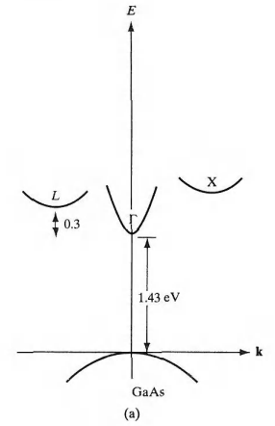
Effective Mass
The electron effective mass in GaAs is much smaller in the direct Γ conduction band (strong curvature) than in the L or X minima (weaker curvature, smaller value in the denominator of the m* expression).

Slide 42

Effective Mass
Note That:
the cur­vature of d²E/dk² is positive at the conduction band minima, but is negative at the valence band maxima.
Thus, the electrons near the top of the valence band have negative effective mass,
Valence band elec­trons with negative charge and negative mass move in an electric field in the same direction as holes with positive charge and positive mass.
we can fully account for charge transport in the valence band by considering hole motion.
For a band centered at k = 0 (such as the Γ band in GaAs), the (E, k) relationship near the minimum is usually parabolic.

Slide 43
Hall Effect
If a current carrying conductor is placed in a transverse magnetic field, potential is developed in the conductor in the direction perpendicular to both the current and magnetic field. This phenomenon is known as Hall Effect. It was discovered by Hall in 1879.

Slide 44
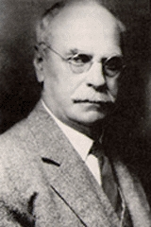
Hall Effect
In 1879, while working on his doctoral thesis, Hall was pursuing the question first posed by Maxwell as to whether the resistance of a coil excited by a current was affected by the presence of a magnet.
Does the force act on the conductor or the current?
Hall argued that if the current was affected by the magnetic field then there should be "a state of stress... the electricity passing toward one side of the wire."
Edwin H. Hall
1855 - 1938

Slide 45
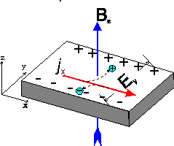
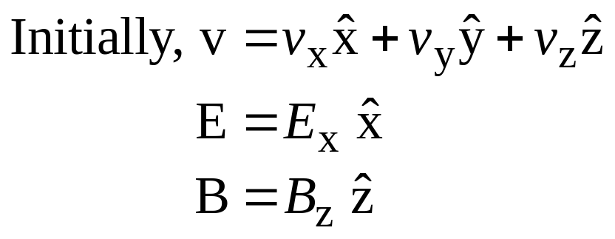
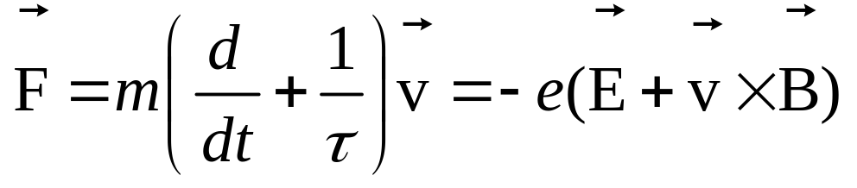
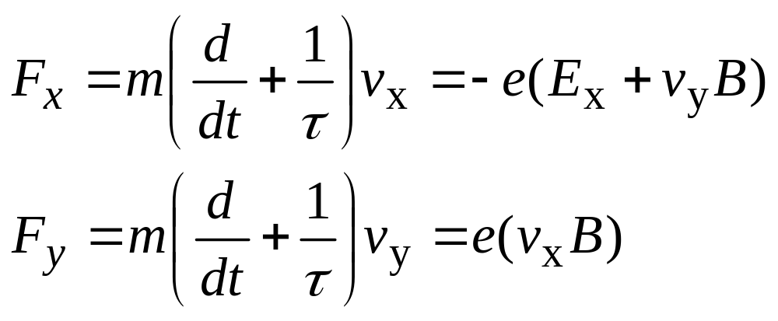
Hall Effect
net force in
−x direction
net force in
−y direction

Slide 46
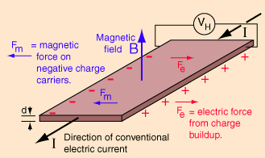
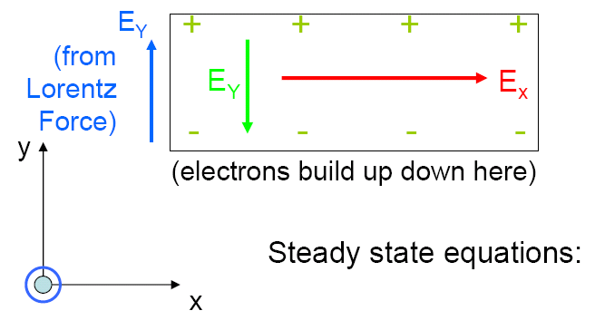
Hall Effect
As a result, electrons move in the −y direction and an electric field component appears in the y direction, E_{y}. This will continue until the Lorentz force is equal and opposite to the electric force due to the buildup of electrons – that is, a steady condition arises.
B
Notes:
The Hall Effect occurs when we apply an electric field in the x-direction and a magnetic field in the z-direction (which generates an electric field in the y-direction).

Slide 47
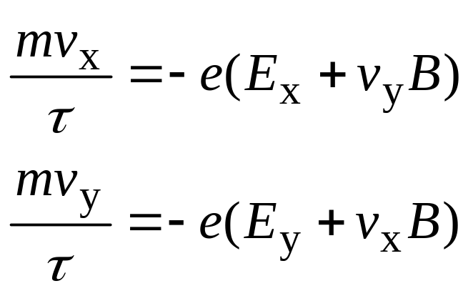
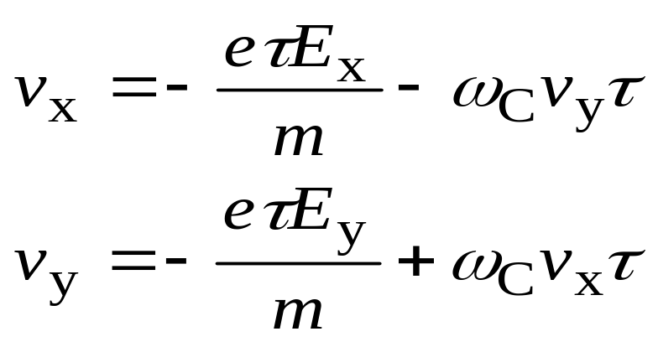
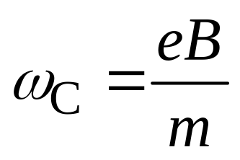

Hall Effect
Steady State
Conditon
Let
Notes:
For electrons moving in the z-direction, we have: v_{z}= 0 (they don’t feel the magnetic field), unless there is an electric field and then we have: v_{z}= -(eτ/m)E_{z}.
Cyclotron Frequency
If the current can’t flow out of the metal in the y-direction, then in the steady state, the velocity of the electrons in the y-direction must be zero (v_{y}= 0).

Slide 48
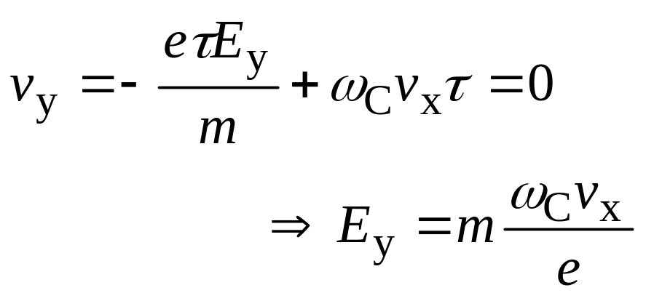
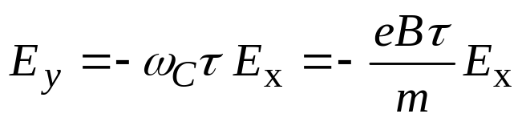
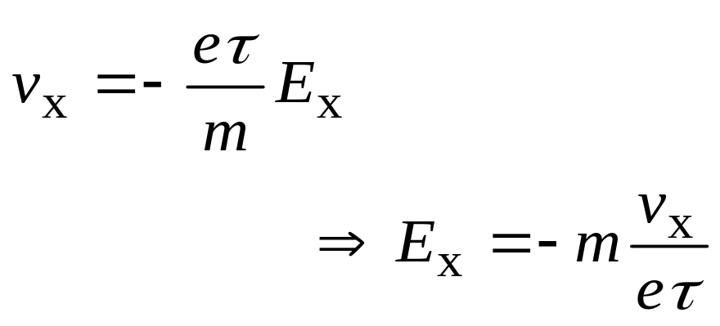
Hall Effect
Notes:
So, what happens is that we get a net flow of electrons in the x-direction, but we also get an electric field set up in the y-direction.
Hall Effect measurements compare the ratio of the field created in the y-direction, to the current in the x-direction, and the magnetic field in the z-direction.

Slide 49
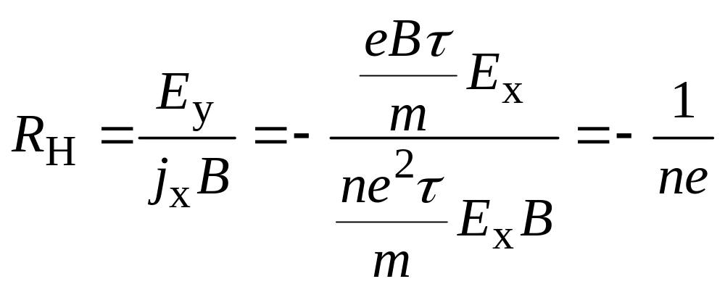
Hall Effect
The Hall coefficient is defined as:
Conduction
Electron
Density
For copper:
n = 8.47 × 10²⁸ electrons/m³.

Slide 50
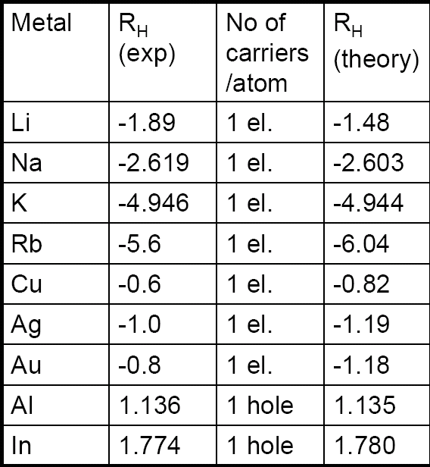
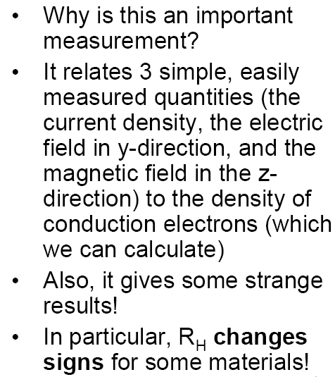
Hall Effect

Slide 51
Hall Effect: Electrons & Holes
The Hall Effect experiment suggests that a carrier can have a positive charge.
These carriers are “holes” in the electron sea - the absence of an electron acts as a net positive charge. These were first explained by Heisenberg.
We can’t explain why this would happen with our free electron theory.
Note: the conditions we derived for the steady state can be invalid for several conditions (for example, when there is a distribution of collision times). But in general, it is a very powerful tool for looking at properties of materials.

Slide 52
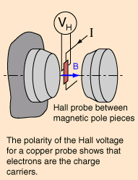
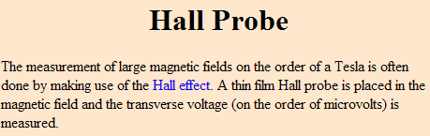
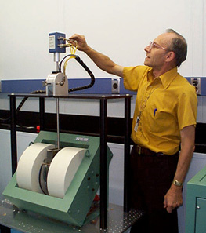
Hall Effect: Applications
For a 100-μm thick Cu film, in a 1.0 T magnetic field and through which I = 0.5 A is passing, the Hall voltage is 0.737 μV.
Notes:
For many years the Hall effect was not used in practical applications because the generated voltage in the gold film was extremely low. However, in the second half of the 20th century the mass production of semiconductor chips started. Chips based on the Hall effect became inexpensive and widely available.

Slide 53
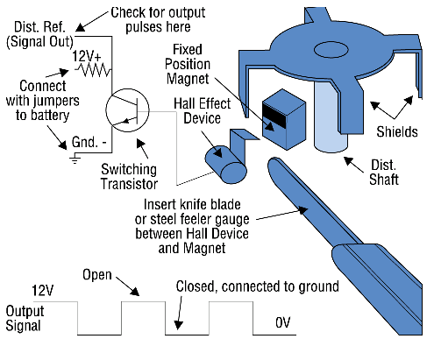
Hall Effect: Applications
Hall-Effect Position Sensors
Hall-Effect position sensors have replaced ignition points in many distributors and are used to directly detect crank and/or cam position on distributorless ignition systems (DIS), telling the computer when to fire the coils. Hall-Effect sensors produce a voltage proportional to the strength of a magnetic field passing through them, which can come from a permanent magnet or an electric current. Since magnetic field strength is proportional to an electric current, Hall-Effect sensors can measure current. They convert the magnetic field into millivolts that can be read by a DMM.
Notes:
But they are also used in many distributorless ignition systems (DIS) to determine the position of the crankshaft and camshaft. This is because the engine computer needs to know where the number one cylinder is as soon as the engine is cranked. As soon as the all-important “sync-pulse” is detected, the ignition module can start firing the plugs in the correct sequence. This also allows injector timing to be matched to the firing order in engines with sequential fuel injection.
Hall Effect Sensors are sometimes referred to as “switches” rather than sensors because of the on-off “digital” voltage signal they produce. Unlike magnetic sensors that produce an alternating current (AC) signal which varies in voltage with speed, Hall Effect Sensors produce a constant voltage signal that can change abruptly from maximum voltage to nearly zero and back again regardless of engine speed.
This produces a square wave output signal that can be easily used by the onboard computer for timing purposes.

